Slide 1
Failed Banking Transaction Analysis
Presented by: Tharunteja Nakkala

Slide 2
Project Overview
Objective: To automate the detection and analysis of failed banking transactions across 15 branches in 3 cities using Google Cloud tools.
Summary:
Ingest CSV files from branches using Google Cloud Storage
Process data with PySpark on Dataproc
Store clean data in Cloud SQL
Analyze trends using BigQuery
Visualize with Looker Studio

Slide 3
Problem Statement
Problem:
Banks handle thousands of transactions daily.
Transaction failures cause significant customer dissatisfaction and financial repercussions.
Manually identifying and analyzing failed transactions is time-consuming and inefficient.
Solution:
Implementing an automated, cloud-based system to detect and analyze failed transactions in real-time.

Slide 4
Tools & Technologies Used
Google Cloud Storage (GCS): Store raw and processed data
Bucket : To Store data
Google Cloud Dataproc: Run PySpark jobs
PySpark: Clean and filter transaction data
Cloud SQL: Store failed transaction data
BigQuery: Analyze structured data
Looker Studio: Visualize insights

Slide 5
Project Setup & Configuration Cloud Commands & Steps
Project Name: tharunteja-project
Bucket Name: bank-transaction-data
Cluster Name: training-cluster
Region: us-central1 Create GCS Bucket: gsutil mb gs://bank-transaction-data/ Upload CSV Files:
gsutil cp C:\project files\*.csv gs://bank-transaction-data/
Upload PySpark Scripts:
gsutil cp C:\Project files\clean_and_merge.py gs://bank-transaction-data/scripts/
gsutil cp C:\Project files\filter_failed_transactions.py gs://bank-transaction-data/scripts/

Slide 6
Create Dataproc Cluster:
gcloud dataproc clusters create training-cluster \ --region=us-central1 \ --single-node \
--enable-component-gateway \ --image-version=2.1-debian11 \ --project=tharunteja-project
Submit PySpark Jobs:
gcloud dataproc jobs submit pyspark gs://bank-transaction-data/scripts/clean_and_merge.py \
--cluster=training-cluster --region=us-central1
gcloud dataproc jobs submit pyspark gs://bank-transaction -data/scripts/filter_failed_transactions.py \ --cluster=training-cluster --region=us-central1
Data Schema: Fields Used:
txn_id (Transaction ID)
branch_id (Branch Code)
city (City Name)
amount (Transaction Amount)
transaction_status (SUCCESS/FAILED)
txn_date (Transaction Date)
customer_id (Customer Unique ID)

Slide 7
Cloud SQL Table Creation:
CREATE TABLE failed_transactions (
txn_id VARCHAR(100),
branch_id VARCHAR(50),
city VARCHAR(50),
amount FLOAT,
transaction_status VARCHAR(20),
txn_date DATE,
customer_id VARCHAR(50)
);
Visual Insights with Looker Studio:
City-Wise Failed Transactions
Date-Wise Failed Transaction Amount
Branch & Customer Analysis
Key Insights Summary
Total Failed Transaction Amount (7 days): ₹3.2M+
Top Failure Date: May 7, 2025
Most Affected City: Hyderabad

Slide 8
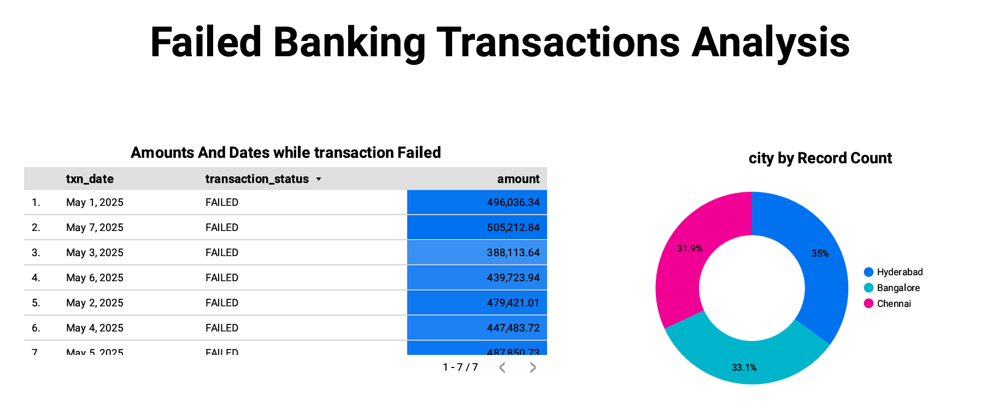

Slide 9
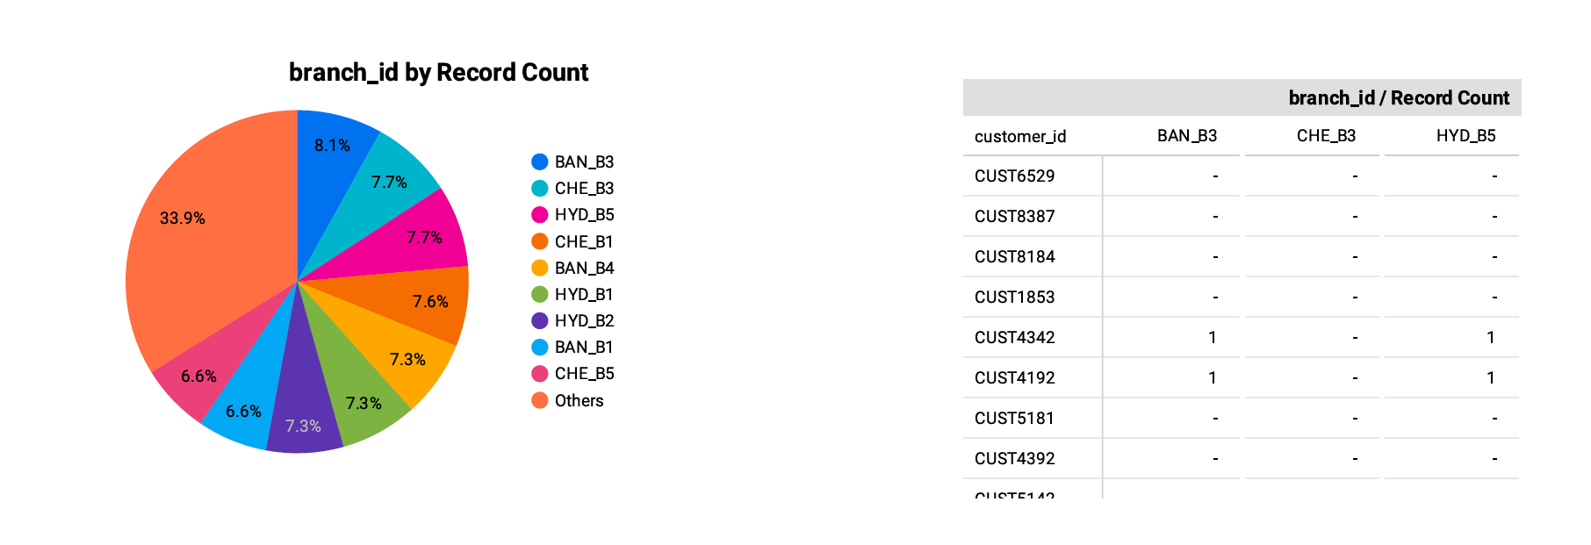
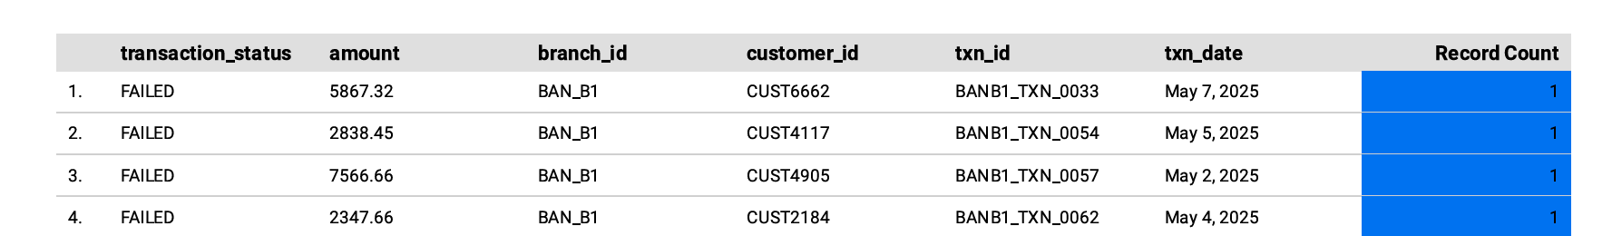

Slide 10
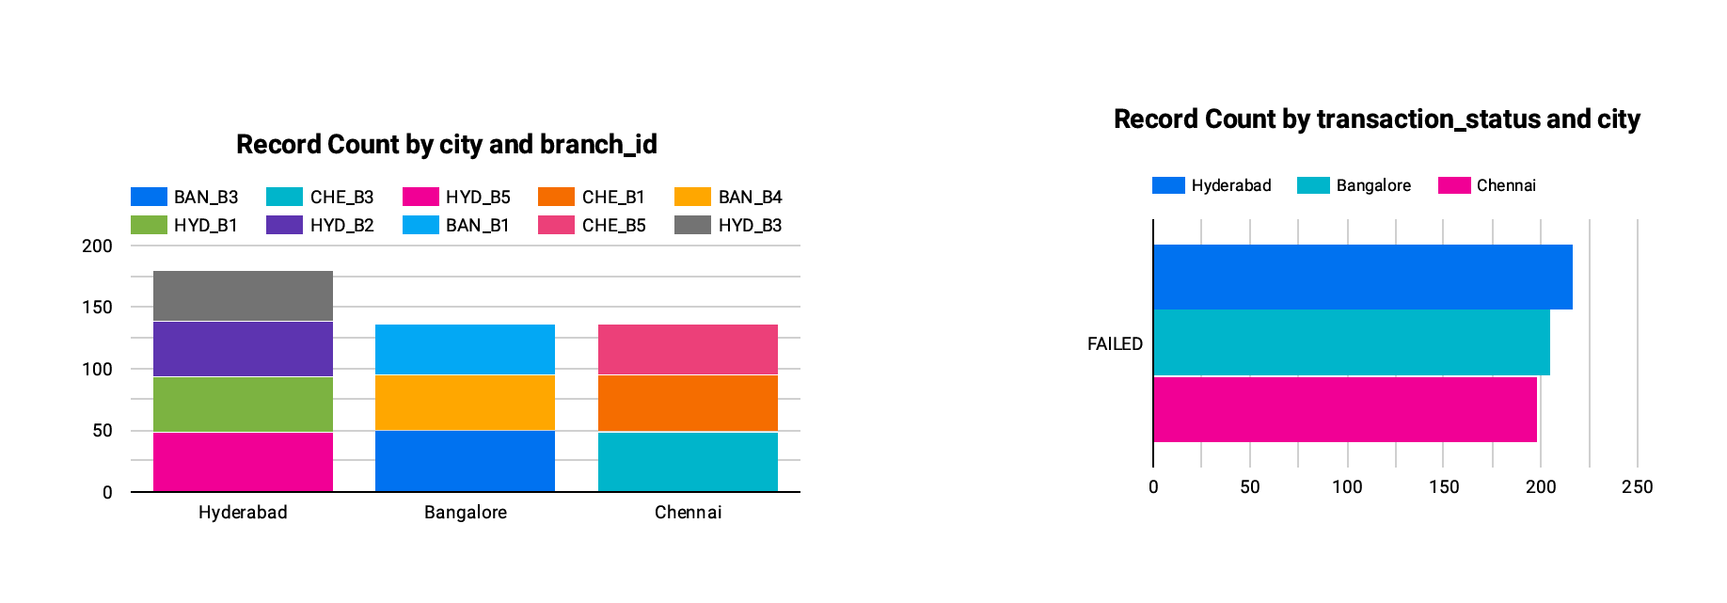
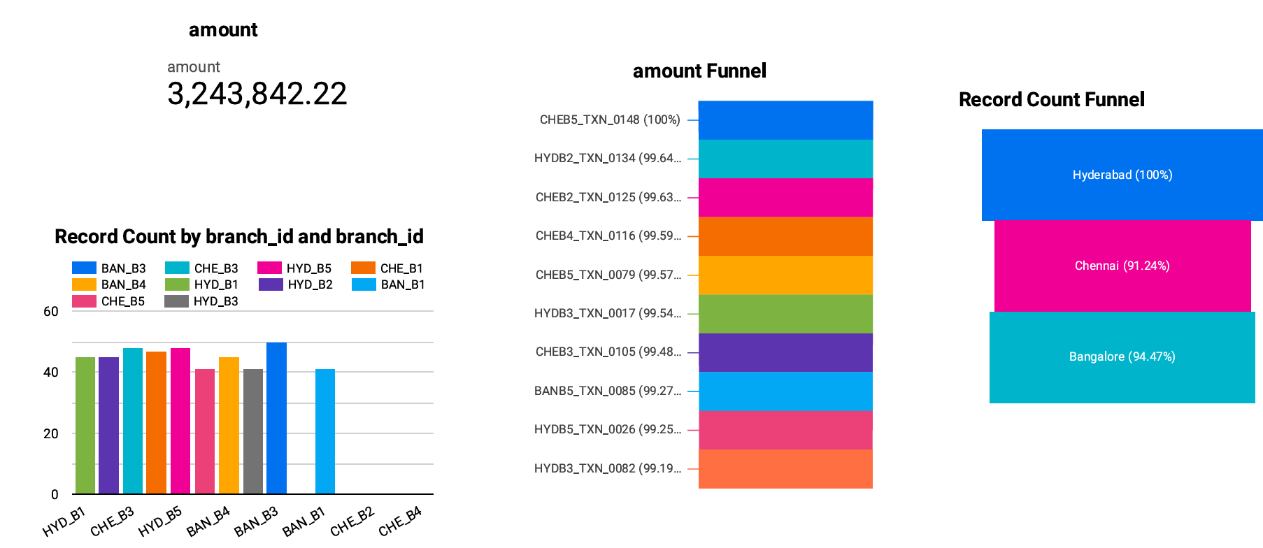

Slide 11
Conclusion
Full pipeline automation using Google Cloud
3,000+ records cleaned and filtered using PySpark
Data stored securely in Cloud SQL
Visual insights generated via BigQuery & Looker Studio
Future Enhancements:
Machine Learning to predict transaction failure likelihood
Automated Alerts for repetitive failure patterns
Historical Comparison Dashboards in Looker Studio
Role-based Access Control for secure analytics

Slide 12
Acknowledgements
Thanks to trainers and mentors or friends who helped in the project.
Thanks to Google Cloud for its powerful ecosystem
THANK YOU

